Slide 1

Convolutional Neural Networks
Edge detection example
deeplearning.ai

Slide 2
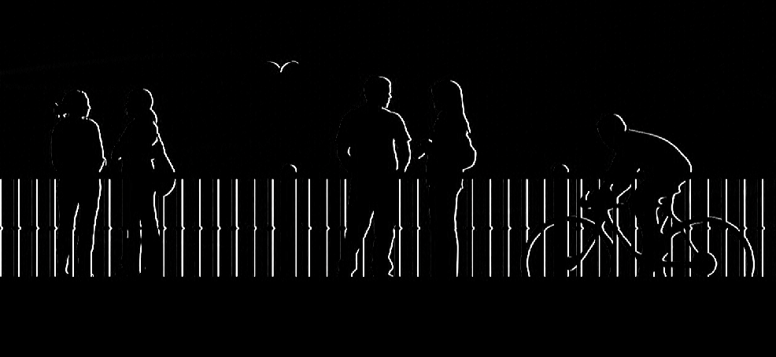
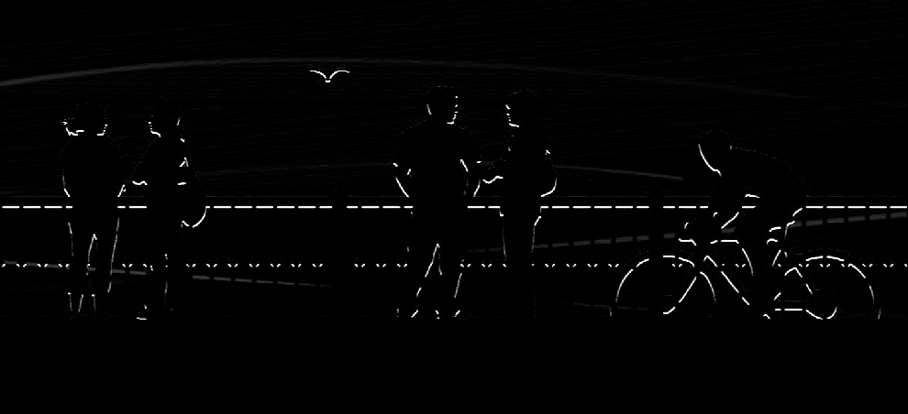
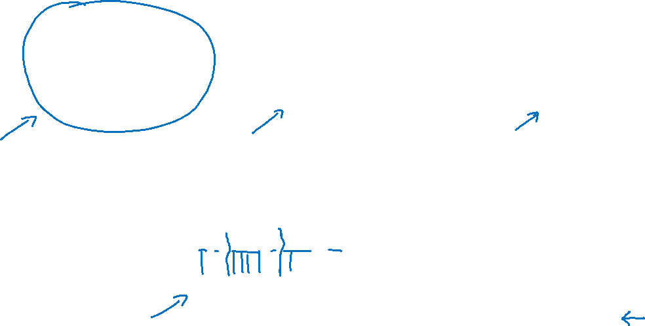
Computer Vision Problem
vertical edges
horizontal edges

Slide 3


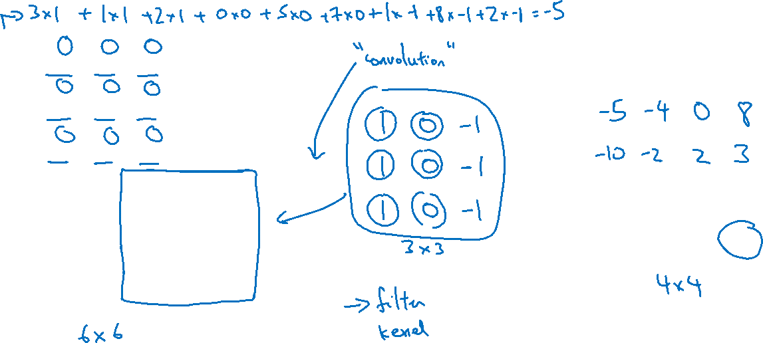
Vertical edge detection
1
1
-1
0
1
1
0
-1
-1
-1
0
0
3 | 0 | 1 | 2 | 7 | 4
1 | 5 | 8 | 9 | 3 | 1
2 | 7 | 2 | 5 | 1 | 3
0 | 1 | 3 | 1 | 7 | 8
4 | 2 | 1 | 6 | 2 | 8
2 | 4 | 5 | 2 | 3 | 9
1
1
1
1
1
0
-1
0
-1
1
0
-1
1
1
0
-1
0
-1
-1
-1
-1
0
0
0
1
1
1
1
0
-1
0
0
-1
1
0
0
-1
-1
1
-1
1
0
-1
1
0
-1
0
-1
$$∗$$
$$=$$
1
0
-1
1
0
-1
1
1
0
-1
0
-1
0 | -2 | -4 | -7
-3 | -2 | -3 | -16

Slide 4


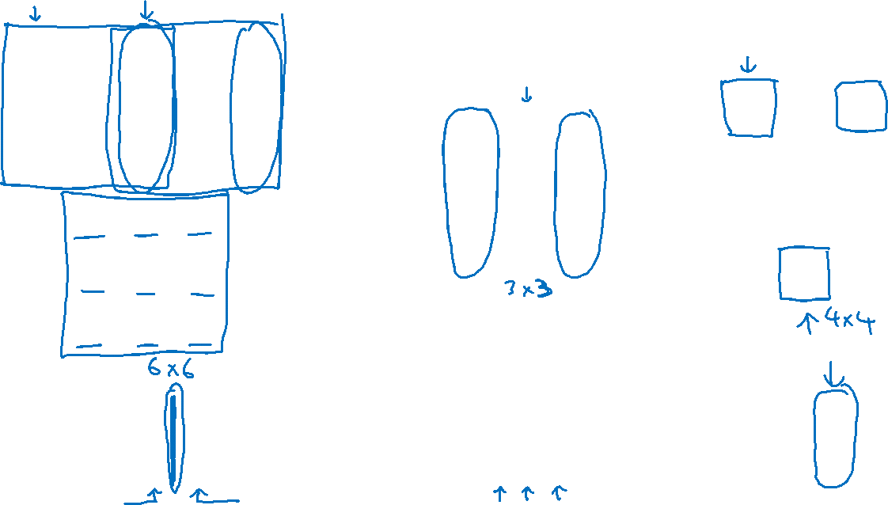

Vertical edge detection
10 | 10 | 10 | 0 | 0 | 0
10 | 10 | 10 | 0 | 0 | 0
10 | 10 | 10 | 0 | 0 | 0
10 | 10 | 10 | 0 | 0 | 0
10 | 10 | 10 | 0 | 0 | 0
10 | 10 | 10 | 0 | 0 | 0
0 | 30 | 30 | 0
0 | 30 | 30 | 0
0 | 30 | 30 | 0
0 | 30 | 30 | 0
1 | 0 | -1
1 | 0 | -1
1 | 0 | -1
$$∗$$
$$=$$
$$∗$$

